Slide 1

STA324 The Foundations and Applications of Large Language Models
2025-2026 Spring Semester
Linyi Yang
Lecture 2 2026/01/19

Slide 2

https://ai.paratera.com/#/cloud/compute
Lecture 1

Slide 3
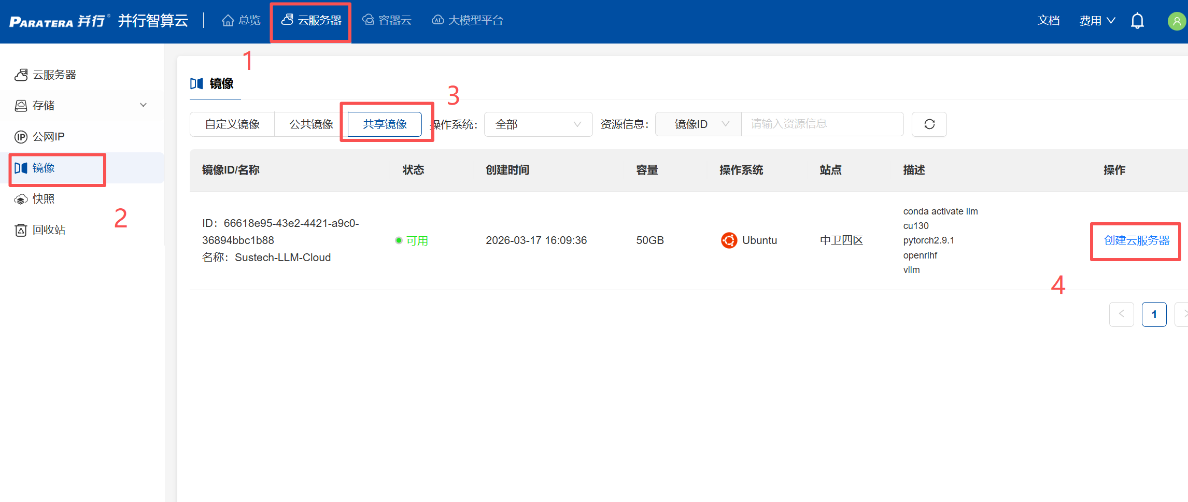
云服务器 -> 镜像 -> 共享镜像 -> 创建云服务器
(SUSTech-LLM)
E2.2 Decoding

Slide 4
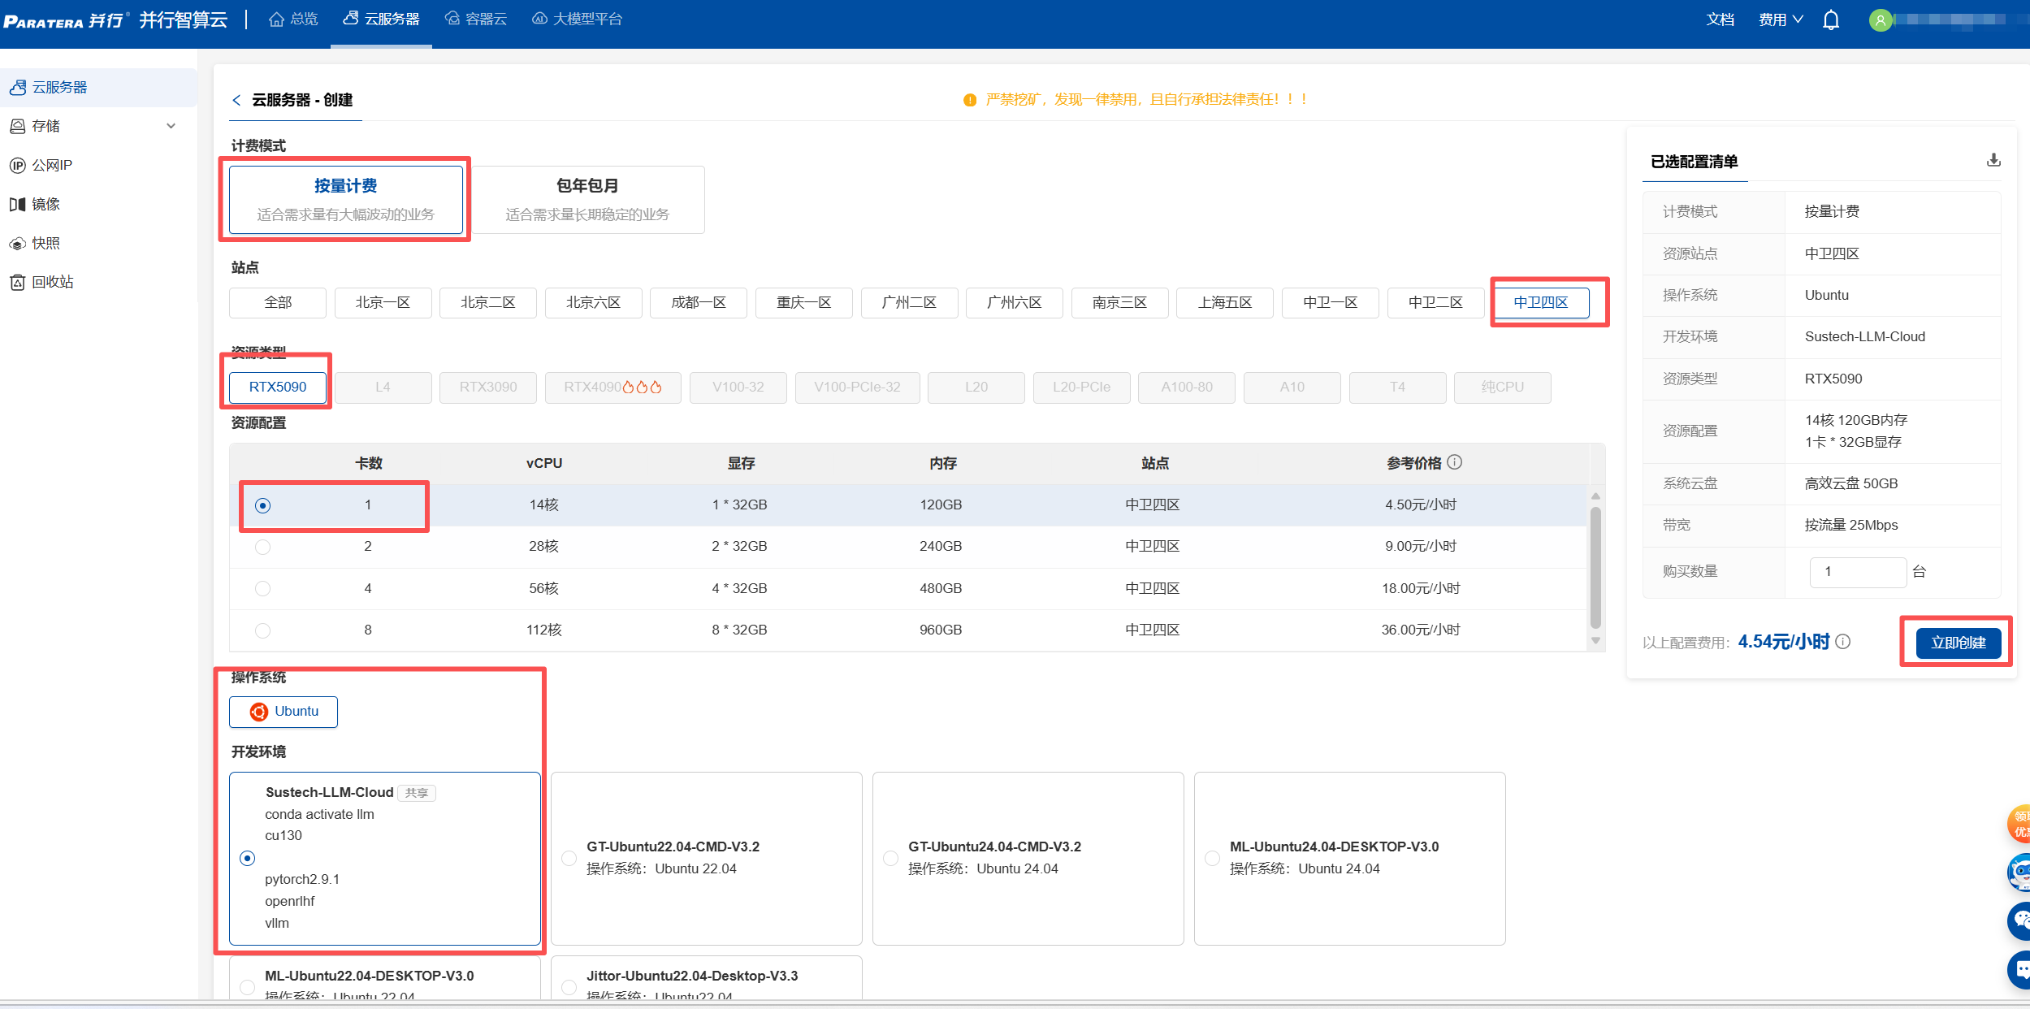
确保所有设置如图所示。剩余参数使用默认设置。无需添加数据盘。
E2.2 Decoding

Slide 5
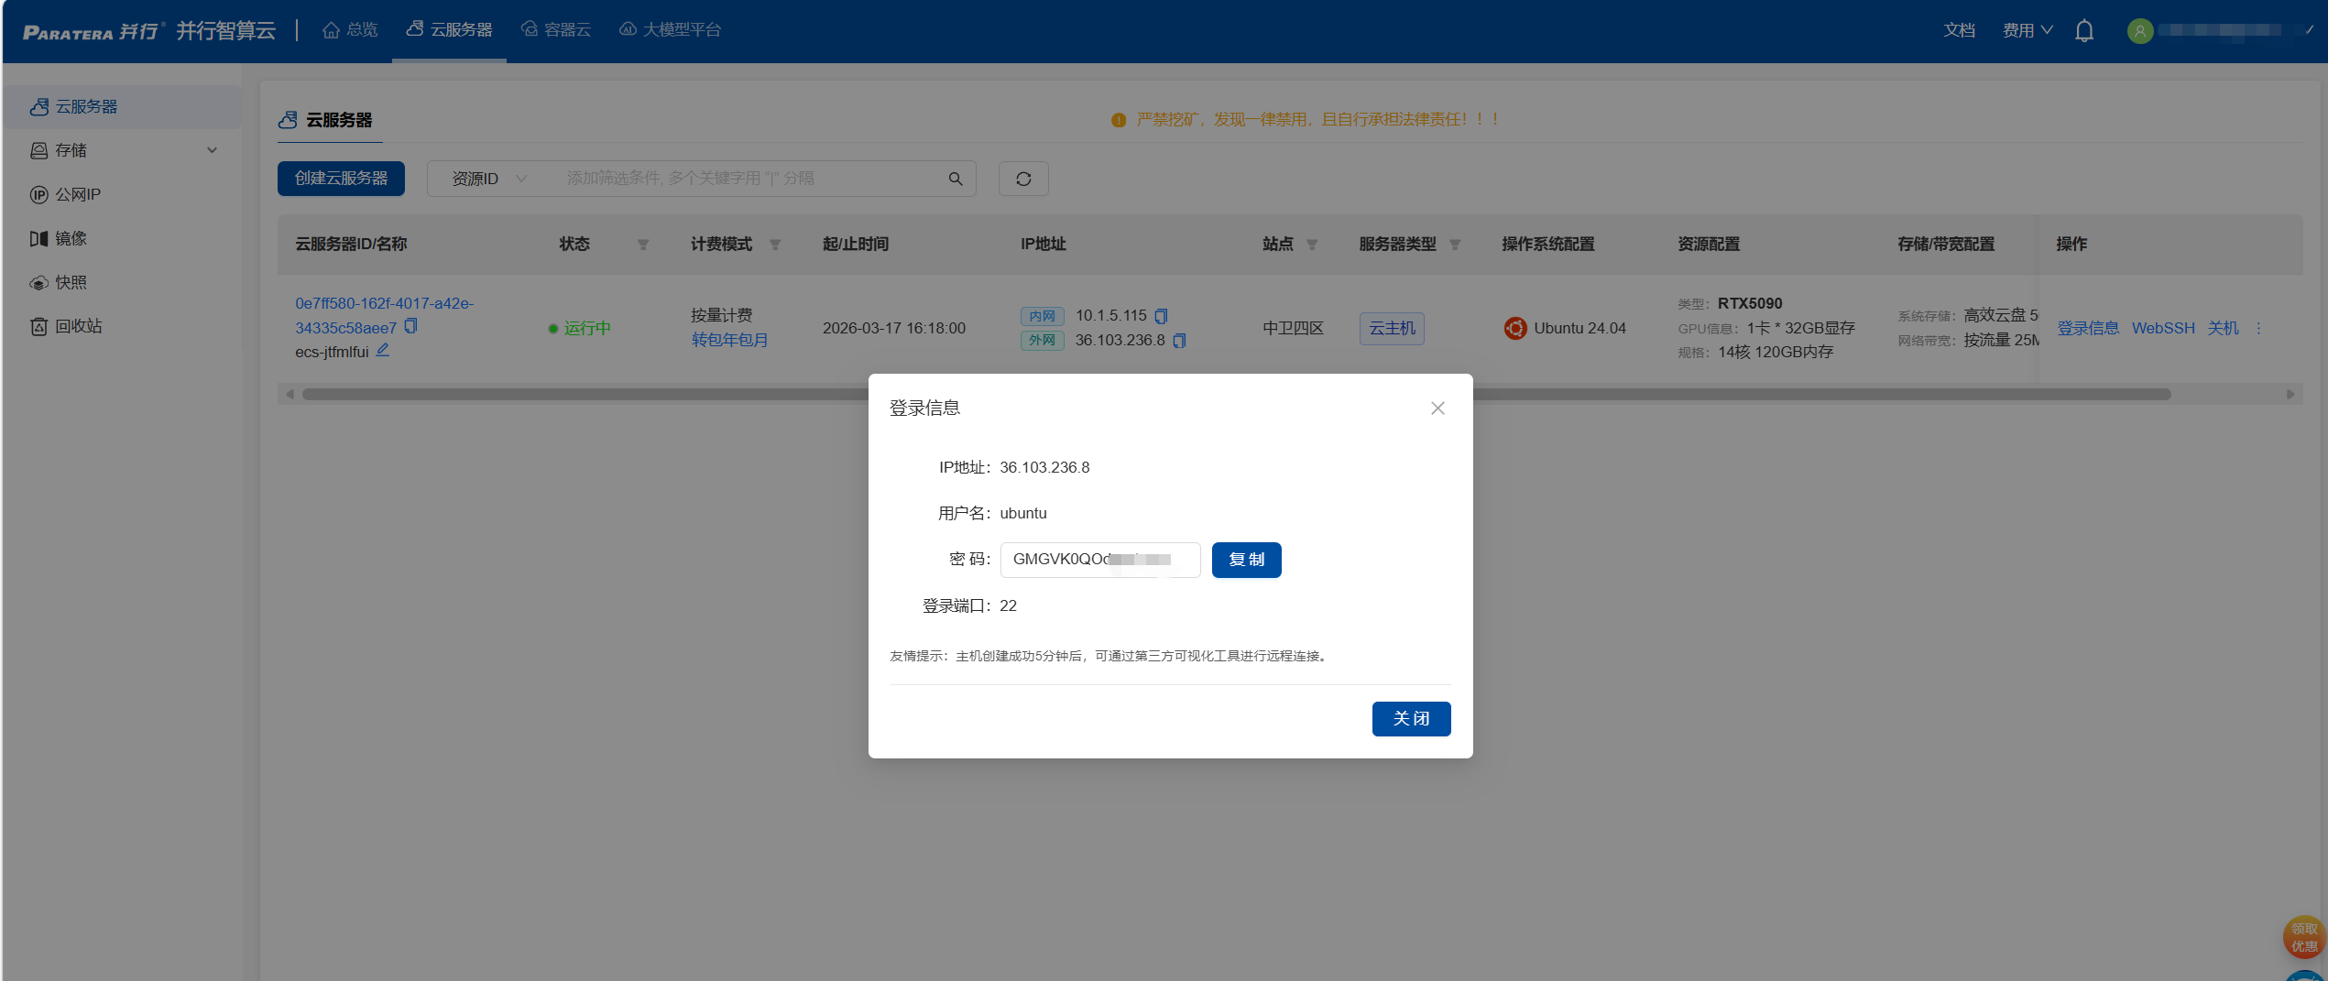
等待创建完毕后，点击登录信息。获取ip地址、用户名、密码等
E2.2 Decoding

Slide 6
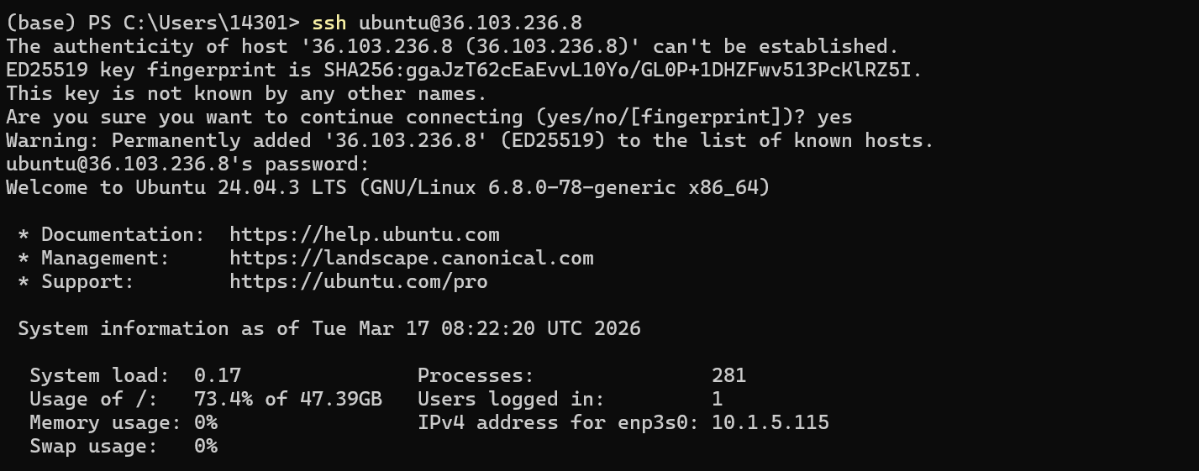
使用你的终端（或者xshell等软件）去连接服务器。
ssh <用户名>@<IP地址>
yes
<密码>
E2.2 Decoding

Slide 7
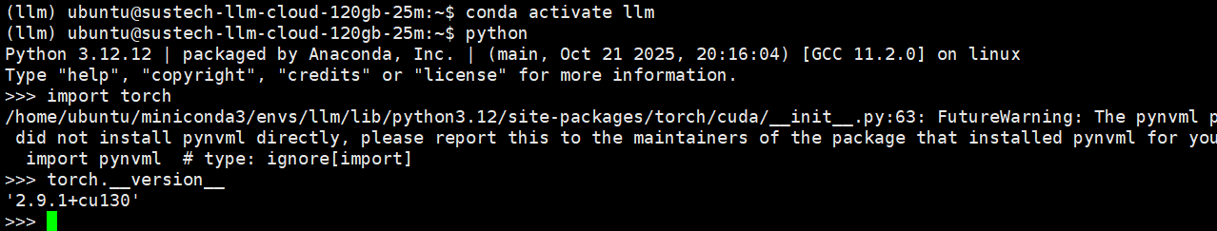
conda activate llm
进入llm环境，此处可以使用pytorch、vllm、openrlhf等工具
E2.2 Decoding

Slide 8
Outline
E2. Model Inference and Prompt Engineering
E2.1 Prompt
E2.2 Decoding
E2.2 Decoding

Slide 9
Training of LLMs
# Full Sentence: [A, B, C, D]
# We want model to predict: A->B, AB->C, ABC->D
# 1. Parallel Forward Pass: Compute all probabilities at once
# Masking ensures Pos 1 only sees A, Pos 2 only sees A+B
logits = model(input=[A, B, C])
# 2. Calculate Loss: Compare all predictions against [B, C, D] simultaneously
loss = cross_entropy(logits, target=[B, C, D])
# 3. Update: One step learns from the whole sequence
loss.backward()
c
Who
Are
Token
Who
Are
You
Who
Are
You
LLM
Who
Are
You
You
Next Token
Are
You
?
1 Step
Loss
0.6
0.4
0.1
E2.2 Decoding

Slide 10
Inference of LLMs
# Prompt: [A, B]
history = [A, B]
# Loop is mandatory: We are building the bridge as we walk on it
for _ in range(max_len):
# 1. Predict based on current history
logits = model(history)
# 2. Pick the next word (e.g., "C") from the last position
next_token = sample(logits[-1])
# 3. CRITICAL: The output "C" must be appended to generate "D"
history.append(next_token)
c
Who
Are
Token
Who
+
Are
+
You
Who
Are
You
LLM
LLM
LLM
Who
Are
You
?
Next Token
Are
You
?
3 Step
E2.2 Decoding

Slide 11
Why is Prefill fast but Decode slow?
1. Training Phase
Mechanism:Teacher Forcing.
Data Flow:Parallel. The model receives the full "Ground Truth" at once.
Operation: Uses Causal Masking to calculate loss for all token positions simultaneously in a single forward pass.
Bottleneck:Compute Bound (High Arithmetic Intensity).
The GPU cores are fully saturated computing massive matrix multiplications.
2. Inference Phase
Mechanism:Autoregressive Generation.
Data Flow:Serial. The future is unknown and must be created.
Operation:Token-by-Token. The output of step $t$ ($y_t$) becomes the mandatory input for step $t+1$ ($x_{t+1}$).
Bottleneck:Memory Bound (Low Arithmetic Intensity).
The GPU spends time moving weights from HBM to cores for every single token generated.
Training calculates the future in parallel; Inference must experience time sequentially.
E2.2 Decoding

Slide 12
vllm
PagedAttention (KV cache management), continuous batching:
These are among the core selling points behind vLLM’s high performance and efficiency.
Automatic Prefix Caching:
Requests that share the same prefix can reuse the KV cache, making it particularly suitable for scenarios such as multiple queries over the same long document or multi-turn conversations with reused dialogue history.
E2.2 Decoding

Slide 13
vllm
Specific:
Best-in-class serving throughput performance
Uses PagedAttention to optimize KV cache memory management
Dynamic batching
Optimized CUDA kernels
Usability:
High-throughput serving with various decoding algorithms, including parallel sampling, beam search, etc.
Tensor parallelism (TP) to support distributed inference
Streaming output
OpenAI-compatible API service
E2.2 Decoding

Slide 14
vllm
Let’s start experimenting.
E2.2 Decoding

Slide 15
End of E2
E2.2 Decoding

